Slide 1
Hungry Go THERE
When you don’t know what to eat, where to eat, and how to get there.

Slide 2

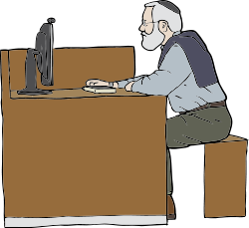
User Story #1
Okay can! But we’re very bored of the food in the canteen already.
WHERE CAN EAT?
It’s finally Lunchtime!
Let me check with Hungry Go There!
Guys, want to go have lunch together?

Slide 3
Hungry Go There!
Where Can Eat?
Halfway Eat Where

Slide 4
Back
Where Are You?
NUS School of Computing
Use My Current Location
How You Go?
Walk
Drive
Tell Me Where Can Eat!

Slide 5
Back
Where Are You?
NUS School of Computing
Use My Current Location
How You Go?
Walk
Drive
Tell Me Where Can Eat!

Slide 6
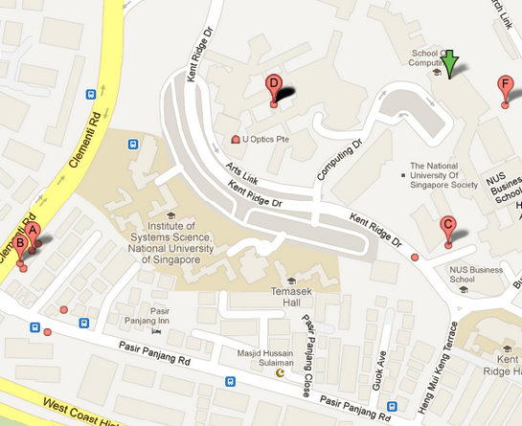
Back
LIST VIEW

Slide 7

Back
Map View
A
The Cheese Prata Shop
18 Clementi Rd, Singapore 129747
+65 6872 1030
627m West
B
Ameen Makan House
12 Clementi Rd, Singapore 129742
+65 6774 0637
650m South-West
C
The University Lounge
11 Kent Ridge Drive, Shaw Foundation Alumni House 4/L, 119244
+65 6779 8919
230m South

Slide 8
User Story #2
ONE HOUR? Our lunch break is one hour only!
Ya lor, the other time we used an app with a similar name, we waited for an hour.
What is that app? Reliable or not?
Let me check with Hungry Go There!
Wah! So good ah?
Don’t worry. This app also tells me around how long we need to wait!

Slide 9
Back
LIST VIEW

Slide 10
Back
The Cheese Prata Shop
18 Clementi Rd, Singapore 129747
+65 6872 1030
627m West
7.8
Rate this shop
Estimated Waiting Times
Queuing – 15 min
In Between – 10 min
What Other People Think
Andrew Lee – Very nice Cheese Prata! Turnover is very fast, so you don’t have to wait very long even during lunch time. Bad thing is very hot!
Melissa Ong – I think so so only. What I recommend is the egg prata. I think it is better than the cheese one. Milo dinosaur also very gd!

Slide 11


User Story #3
Hello Jane, what would you like for dinner?
Oh yes! Let me check with Hungry go There!
No! I’m bored of the food around home.
What about the food around home?
No! The food will be cold by the time you come home!!
What about the food around my office?
FUUUUUUUUUUU
So… What would you like to eat?
Anything.
Anything!

Slide 12
Hungry Go There!
Where Can Eat?
Halfway Eat Where

Slide 13
Back
Where Are You?
NUS School of Computing
Use My Current Location
Where You Going?
771 Clementi Avenue 6
Tell Me Halfway Eat Where!

Slide 14
Back
Where Are You?
NUS School of Computing
Use My Current Location
Where You Going?
771 Clementi Avenue 6
Tell Me Halfway Eat Where!

Slide 15
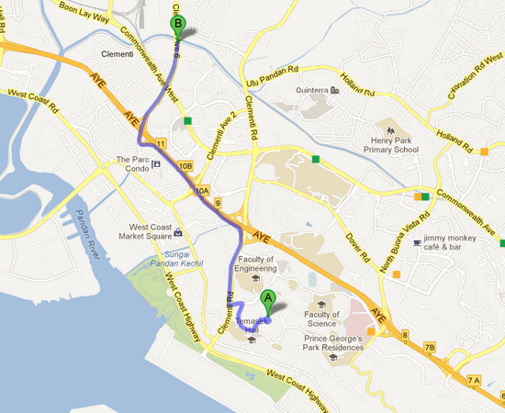
Back
3
2
1
LIST VIEW

Slide 16
Back
Map View
1
Astons
325 Clementi Ave 5, #01-155, Singapore 120325
+65 6778 9406
15min Detour
2
Botak Jones
325 Clementi Ave 5, #01-129, Singapore 120325
+65 6774 1225
15min Detour
3
Swensens @ Clementi
3155 Commonwealth Ave West, #05-31/32/33, Clementi Mall
+65 6659 2151
20min Detour

Slide 17
Back
Botak Jones
325 Clementi Ave 5, #01-129,
Singapore 120325
+65 6774 1225
15min Detour
7.7
Rate this shop
Estimated Waiting Times
Queuing – 5 min
Serving – 10 min
What Other People Think
Andrew Lee – BOTAK JONES! Damn good food at a damn good price! The chilli cheese fries are very nice. Must Try!
Melissa Ong – I think a bit over-rated. The Fish and Chips are a bit dry. But the portion is good and the price is right.

Slide 18
Hungry Go THERE
When you don’t know what to eat, where to eat, and how to get there.

